Slide 1

Portfolio Optimization
with Monte Carlo Simulation

Slide 2

Contents
 | Data Collection & Market Conditions
 | Model Overview & Optimization Using Mean-Variance Method
 | Returns vs Risk From MC Simulation
How to improve the model and some other methods for portfolio optimization.

Slide 3

Data Collection & Market Conditions

Slide 4
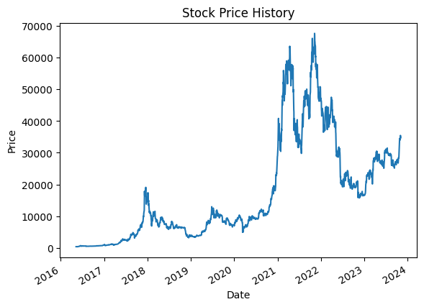
Data Collection & Market Conditions
Cryptocurrency Crash
Data is collected for following assets across different asset classes:
2017 DEC
GOOGL – Alphabet Inc. (Stock)
AAPL – Apple Inc. (Stock)
TSLA – Tesla, Inc. (Stock)
AMZN – Amazon.com, Inc. (Stock)
MSFT – Microsoft Corporation(Stock)
GME – GameStop Corp. (Stock)
GC=F – Gold Dec 23(Precious Metal)
SI=F - Silver Dec 23(Precious Metal)
BTC-USD – Bitcoin USD(Cryptocurrency)
BFIT – Global X Health & Wellness(ETF)
INTC – Intel Corporation(Stock)
DIS – The Walt Disney Company(Stock)
PFE – Pfizer Inc. (Stock)
Market decline due to covid
2020 FEB
GameStop Market Manipulation
2021 JAN
Stocks Sell off due to Russia-Ukraine Invasion
2022 Aug-Dec

Slide 5
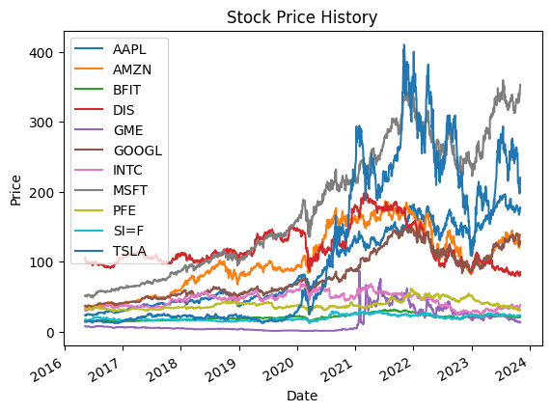
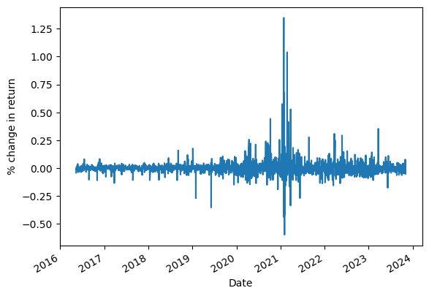
Data Collection & Market Conditions
BTC-USD
Cryptocurrency Crash
2017 DEC
Market decline due to covid
2020 FEB
GME
GameStop Market Manipulation
2021 JAN
Stocks Sell off due to Russia-Ukraine Invasion
2022 Aug-Dec

Slide 6
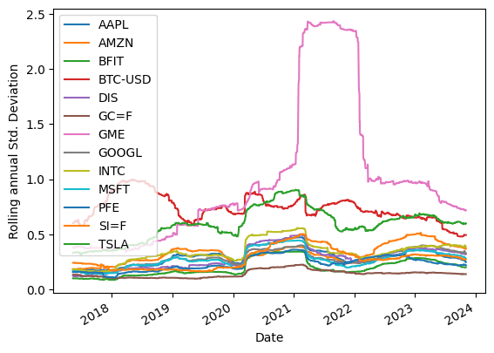
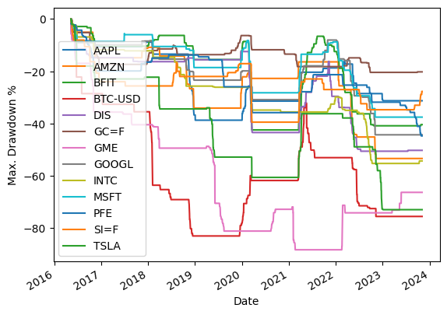
Data Collection & Market Conditions
Mean Returns %
Even Though BTC-USD, GME and Tesla give very high returns they also have a high volatility and drawdown.
Stocks with drawdown more than 50% are not preferred to invest in. To recover from a 50% drawdown, we would require a 100% gain.
High numbers of GME stock is due to the market manipulation by short selling of stock.
Even Though returns of precious metals are low but they come at very less risk. Because of lack of regulation in cryptocurrency even though the mean returns are large we would not be investing in it.
AAPL | 31.481494
AMZN | 23.805408
BFIT | 6.636170
BTC-USD | 84.198362
DIS | 1.175299
GC=F | 7.125761
GME | 71.831950
GOOGL | 20.892733
INTC | 9.216384
MSFT | 29.811518
PFE | 2.463306
SI=F | 8.214067
TSLA | 54.354262

Slide 7
Model
Overview &
Optimization
Using Mean-Variance

Slide 8
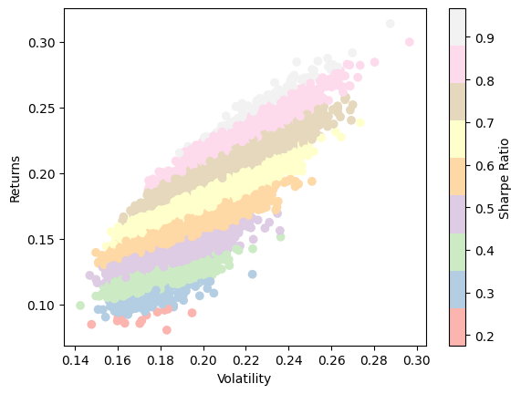
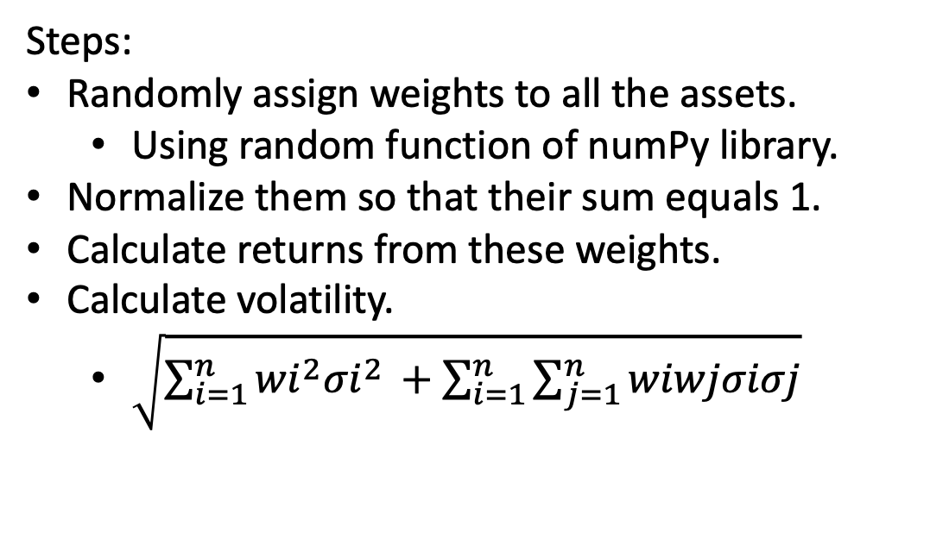
Overview of the Model
No. Of Simulations : 30000
Steps:
Randomly assign weights to all the assets.
Using random function of numPy library.
Normalize them so that their sum equals 1.
Calculate returns from these weights.
Calculate volatility.
$\sqrt{\sum_{i=1}^{n}{{wi}^{2}{σi}^{2 }}+\sum_{i=1}^{n}{\sum_{j=1}^{n}{wiwjσiσj}}}$
Calculate Sharpe ratio.
(Return-Risk free Return)/Volatility
Risk Free Return=4.86% (10 Year US Treasury Bonds return)

Slide 9
Overview of the Model
Sharpe ratio is a metric used that describes a relationship between returns and volatility that how much risk we should take for a a particular return value.
Sharpe ratio around 1 is decent and above 1 is generally good.
Each point on the graph represents a different simulation.

Slide 10
Overview of the Model
Results
MAX SHARPE RATIO
Returns 0.284407
Volatility 0.243797
Sharpe 0.967227
Weights [0.2128886 0.0395617 0.02754405 0.00428686 0.0900618 0.08584253
0.00494058 0.16380732 0.05314167 0.09056743 0.22735748]
MIN VOLATILITY
Returns 0.099383
Volatility 0.142523
Sharpe 0.356313
Weights [0.04399971 0.04136884 0.17541948 0.11596459 0.22759311 0.02598377
0.00723446 0.06103704 0.18152529 0.10331258 0.01656112]
MAX VOLATILITY
Returns 0.299628
Volatility 0.296574
Sharpe 0.846428
Weights [0.1036423 0.23479111 0.04180687 0.00981872 0.00579758 0.04446097
0.14410377 0.05467449 0.01710888 0.03985453 0.30394078]
MAX RETURNS
Returns 0.313611
Volatility 0.287541
Sharpe 0.921645
Weights [0.18700208 0.03421221 0.03273828 0.0039475 0.01436713 0.0061888
0.04096685 0.10776873 0.04066721 0.18257112 0.34957009]
-The weight distribution are in order 'AAPL','AMZN','BFIT','DIS','GC=F','GOOGL','INTC','MSFT','PFE','SI=F','TSLA'

Slide 11



Mean-Variance Optimization
Using Sci-Py library of python and using the optimize function
Optimization using mean-variance method is faster as compared to Monte Carlo simulations.
It is implemented in the following way:
Step 1 : Calculate maximum returns which
is a linear function.
Step 2: Calculate weights corresponding to
minimum risk and then returns corresponding
to the weights.
Step 3: Executing optimization function that calculate
weight distribution for series of return values
between result1 and result2 with minimum
amount of risk for that value.

Slide 12
Returns
vs Risk
From MC Simulation

Slide 13

AGE
A person is supposed to save money for after retirement period. Less working years remaining, less likely a person would be willing to the risk the saved money.
Income
A person earning less money would be less willing to take risk.
Financial Goals
A person’s viewpoint and where they wish to be in future directs risk appetite.
Risk Appetite
How much risk a person is willing to take is dependent on certain factors such as:
These categories represent the general differentiation, but the risk appetite and risk definition varies for everyone.

Slide 14
Risk Appetite
Different assets are associated with different risk. The distinction is as follows:
1.Less Risk – Bonds, Etfs, Precious Metals.
2.Intermediate Risk - Equity
3.High Risk - Cryptocurrency
A person willing to take less risk invests around 80% in 1 and 20% in 2.
A person willing to take intermediate risk invests around 30% in 1 and
60% in 2 and 10% in 3.
A person willing to take High risk invests around 10% in 1 and
55% in 2 and 35% in 3.

Slide 15
Risk vs Return
Analysis

Slide 16
index | Risk | Return | AAPL | AMZN | BFIT | BTC-USD | DIS | GC=F | GOOGL | INTC | MSFT | PFE | SI=F | TSLA
0 | 0.20672436431458677 | 0.23246382623799508 | 0.08510586126715527 | 0.08286987609639185 | 0.0798993100180633 | 0.09804166267892686 | 0.07797505325016257 | 0.08136647650900722 | 0.08236366247101781 | 0.07924348667925646 | 0.0846962777792445 | 0.07939318685386526 | 0.08074239493727099 | 0.08903758637704057
1 | 0.20675530054338556 | 0.2576638262379951 | 0.08511757017489402 | 0.08287687077299637 | 0.07990033260915937 | 0.09808072884134282 | 0.07797218832347144 | 0.08137061741175922 | 0.08236964512025219 | 0.07924311984570462 | 0.08470713341168078 | 0.0793932714804968 | 0.08074518687890953 | 0.08905724599046634
2 | 0.20678624176137797 | 0.2828638262379951 | 0.08512927980843706 | 0.08288386494841961 | 0.07990135304786583 | 0.09811980342756553 | 0.0779693221518159 | 0.08137475917632069 | 0.08237562680425664 | 0.07924275032126411 | 0.08471798903330155 | 0.07939335574818751 | 0.08074798078702866 | 0.08907690801417292
3 | 0.2144702189801627 | 0.3080638262379951 | 0.08622012644793216 | 0.08210277470024058 | 0.0754844459488021 | 0.11782074373720916 | 0.07269499870043912 | 0.07690129024415646 | 0.08093492713967428 | 0.07546514651503418 | 0.08538613814770972 | 0.07418884958604491 | 0.0766097097628181 | 0.09665038954482084
4 | 0.21451470094586922 | 0.3332638262379951 | 0.08623145652914099 | 0.0821057714343267 | 0.07547502797130187 | 0.11790037750235818 | 0.07268043280406233 | 0.07689477016137691 | 0.0809357072379218 | 0.07545554837993498 | 0.085395792410249 | 0.07417721179706298 | 0.0766024781528947 | 0.09668278352216064
5 | 0.21455920178312574 | 0.3584638262379951 | 0.08624278453293935 | 0.08210876115328049 | 0.07546559901872973 | 0.11798005686754369 | 0.07266585370719812 | 0.07688824126287289 | 0.08093647976528594 | 0.07544593881720288 | 0.08540544353948311 | 0.07416556328634329 | 0.07659523820598842 | 0.09671518411287118
6 | 0.21460372057969238 | 0.38366382623799516 | 0.08625411141501443 | 0.082111744606977 | 0.07545615991895602 | 0.11805977566216794 | 0.07265126211101935 | 0.07688170506442044 | 0.08093724476892081 | 0.07543631668924737 | 0.0854150926470504 | 0.07415390477350663 | 0.07658798728789103 | 0.09674759471985558
7 | 0.21464825806308663 | 0.40886382623799516 | 0.08626543619586119 | 0.08211472092948269 | 0.07544670967136126 | 0.11813953982317366 | 0.07263665719835699 | 0.0768751613078977 | 0.08093800117933635 | 0.07542668321950748 | 0.08542473923344526 | 0.07414223557435995 | 0.07658072767814145 | 0.09678001199176876
8 | 0.21469281426861644 | 0.43406382623799517 | 0.08627675867644681 | 0.08211768997879834 | 0.07543724877307158 | 0.11821934714633076 | 0.07262204104544055 | 0.07686860868720007 | 0.08093875098367075 | 0.07541703769310756 | 0.08543438232926542 | 0.07413055547486655 | 0.0765734587753393 | 0.09681243777742142
9 | 0.2148378965889856 | 0.45926382623799517 | 0.08631265611578284 | 0.08208951730387136 | 0.07536847737331193 | 0.11860681031525169 | 0.07249581763365284 | 0.07686754833551467 | 0.08090327066711858 | 0.07530552312946374 | 0.08546025991836048 | 0.07406299725275123 | 0.07652625849499657 | 0.09692377714057974
10 | 0.2330886017203732 | 0.48446382623799517 | 0.08599055045986884 | 0.07888055339125029 | 0.0673847066753551 | 0.1637459399922417 | 0.06365188682336301 | 0.06872005071499614 | 0.07674106737416445 | 0.0681610356754411 | 0.08445579560922041 | 0.06520948843787183 | 0.06882762516061451 | 0.10917070179509832
11 | 0.27779463566403134 | 0.5096638262379952 | 0.07906395262011497 | 0.06923177919724186 | 0.054475160338196174 | 0.26389035775531144 | 0.05052655377137599 | 0.05555538697140616 | 0.06629753361706942 | 0.05584578501595063 | 0.07682294360589059 | 0.05193413584111222 | 0.055974554426607884 | 0.12088377804249553
12 | 0.2779992976008487 | 0.5348638262379951 | 0.07905173026449634 | 0.06920457053022436 | 0.05442892381354826 | 0.26427083757159914 | 0.0504759288082346 | 0.05551064107347808 | 0.06626630169839486 | 0.05580121450473119 | 0.0768072290186055 | 0.05188536691943002 | 0.055930190120291844 | 0.12094570796027239
13 | 0.2782041381605879 | 0.5600638262379951 | 0.0790395167296448 | 0.06917734835046295 | 0.05438264641685881 | 0.2646514298122986 | 0.050425262237347813 | 0.05546586172347197 | 0.06623504416199595 | 0.055756610691224624 | 0.07679151243184541 | 0.05183657423298122 | 0.05588580323689465 | 0.12100771871782862
14 | 0.2784091906895387 | 0.5852638262379951 | 0.07902725269606464 | 0.06915008386142427 | 0.054336354070916845 | 0.26503226935057606 | 0.05037458559437812 | 0.055421054702821076 | 0.06620375893155639 | 0.05571199275191905 | 0.07677575181505725 | 0.051787771505428404 | 0.05584140289676897 | 0.12106970240639435
15 | 0.2786144320845347 | 0.610463826237995 | 0.07901497581634415 | 0.06912279897937075 | 0.05429003622624401 | 0.2654132610697273 | 0.05032388270361924 | 0.055376227747467754 | 0.06617244664876168 | 0.05566734435612104 | 0.0767599810366645 | 0.051738937497705736 | 0.05579696838419518 | 0.12113173733374205
16 | 0.2788198689211291 | 0.635663826237995 | 0.07900267793988013 | 0.06909549041040261 | 0.05424369002953284 | 0.2657944356781885 | 0.05027315630968998 | 0.05533137274811234 | 0.06614110810305693 | 0.05562267440226702 | 0.07674418762545007 | 0.05169008409004472 | 0.05575251170117286 | 0.12119379136831268
17 | 0.3932804962542713 | 0.6608638262379949 | 0.05634701546338752 | 0.047206392115684864 | 0.03468598624905246 | 0.4801304918011527 | 0.031860545232388834 | 0.03523026297770207 | 0.04453406036380854 | 0.03603533485077244 | 0.05412901204576335 | 0.032725967343987056 | 0.03570105626196071 | 0.11203680710667419
18 | 0.39374814374752304 | 0.6860638262379949 | 0.05628937097308691 | 0.04714111930524152 | 0.03461338489070637 | 0.48089177855559456 | 0.031787101358838346 | 0.035157685066525626 | 0.044466873759235775 | 0.03596367888496437 | 0.05406927072045111 | 0.032652839117318644 | 0.03562873409624884 | 0.1120624105363502
19 | 0.39421585794265457 | 0.7112638262379949 | 0.0562317791878233 | 0.047075838650024224 | 0.034540736744174974 | 0.4816527805951922 | 0.03171361195353072 | 0.03508507108267683 | 0.04439967019497518 | 0.03589198224931858 | 0.054009586704843654 | 0.03257968202056924 | 0.03555636709326575 | 0.11208847711201658
20 | 0.3946837578173802 | 0.7364638262379948 | 0.056174206539940305 | 0.04701053872766328 | 0.03446808619648113 | 0.48241382086079876 | 0.031640101108950325 | 0.03501247547685826 | 0.044332486398125356 | 0.035820279029918266 | 0.05394983836651329 | 0.032506519656951297 | 0.03548401054428485 | 0.11211457774496994
21 | 0.5474551058844562 | 0.7616638262379948 | 0.027256228612889895 | 0.02342911622671764 | 0.017890020493882528 | 0.7360444843146587 | 0.016621614187174588 | 0.018058176216067177 | 0.022249982203490924 | 0.01853326242553551 | 0.026304876786951384 | 0.01694561151705492 | 0.0183081565098072 | 0.05862786937387007
22 | 0.5480017482757817 | 0.7868638262379948 | 0.02718736659593916 | 0.023359017198351123 | 0.017817806313631855 | 0.7368811535642326 | 0.016548716330212078 | 0.01798613648738766 | 0.022179482243118987 | 0.018461165930629995 | 0.026235727212202267 | 0.01687292344325922 | 0.01823616203882933 | 0.05857715476822533
23 | 0.5485453927649444 | 0.8120638262379947 | 0.027118621603509467 | 0.023288985055580212 | 0.017745544833188052 | 0.7377124395053888 | 0.016475768067766534 | 0.01791407535429787 | 0.022109027516525742 | 0.018389054310616687 | 0.02616669352394289 | 0.0168001903492389 | 0.018164161468447536 | 0.05853162575000456
24 | 0.5490889402081108 | 0.8372638262379947 | 0.02704987485562632 | 0.023218936797471966 | 0.017673273913003856 | 0.7385434289891811 | 0.016402812216525633 | 0.017842006021954935 | 0.02203855217426961 | 0.018316930724050114 | 0.026097651391864943 | 0.016727451462614895 | 0.018092152901037547 | 0.05848644849850284

Slide 17
Risk VS Return Assessment
index | Risk | Return | AAPL | AMZN | BFIT | BTC-USD | DIS | GC=F | GOOGL | INTC | MSFT | PFE | SI=F | TSLA
For 20% risk we are getting 23.24% return, and the assets are equally allocated.
0 | 0.20672436431458677 | 0.23246382623799508 | 0.08510586126715527 | 0.08286987609639185 | 0.0798993100180633 | 0.09804166267892686 | 0.07797505325016257 | 0.08136647650900722 | 0.08236366247101781 | 0.07924348667925646 | 0.0846962777792445 | 0.07939318685386526 | 0.08074239493727099 | 0.08903758637704057
For 27.77% risk we are getting 50% return, and allocation to Bitcoin and Tesla which have higher volatility have increased.
11 | 0.27779463566403134 | 0.5096638262379952 | 0.07906395262011497 | 0.06923177919724186 | 0.054475160338196174 | 0.26389035775531144 | 0.05052655377137599 | 0.05555538697140616 | 0.06629753361706942 | 0.05584578501595063 | 0.07682294360589059 | 0.05193413584111222 | 0.055974554426607884 | 0.12088377804249553
For 39.32% risk we are getting 66% return, and allocation to Bitcoin has increased to 48% and to Tesla has decreased.
17 | 0.3932804962542713 | 0.6608638262379949 | 0.05634701546338752 | 0.047206392115684864 | 0.03468598624905246 | 0.4801304918011527 | 0.031860545232388834 | 0.03523026297770207 | 0.04453406036380854 | 0.03603533485077244 | 0.05412901204576335 | 0.032725967343987056 | 0.03570105626196071 | 0.11203680710667419
For 54.47% risk we are getting 76% return, and allocation to Bitcoin has increased to 73% and to Tesla has decreased to only 5.8%.
21 | 0.5474551058844562 | 0.7616638262379948 | 0.027256228612889895 | 0.02342911622671764 | 0.017890020493882528 | 0.7360444843146587 | 0.016621614187174588 | 0.018058176216067177 | 0.022249982203490924 | 0.01853326242553551 | 0.026304876786951384 | 0.01694561151705492 | 0.0183081565098072 | 0.05862786937387007

Slide 18
How to improve the
model and some
other methods for
portfolio optimization.

Slide 19


How to improve the
model
Increase the number of simulations .It will take more time,
but we will have better results.
Consider more assets across different classes.
Removal of assets such as GameStop which the MC simulation
predicts we can high returns, but it is just a result of market
manipulation. Hence knowledge of market is important.
We observed that the highest return is gained when full
weight is allocated to only one weight in optimization
algorithm but certain peaks lack in Monte Carlo simulation.
Using alternate probability distribution will help.

Slide 20

Other Methods
Mean-Variance Optimization
Implemented in the notebook
Modern-Portfolio Theory
Extension of Mean-variance method. It includes correlation between different stocks.

Slide 21


Thank You
Rahul Khatter
21115114

